Slide 1
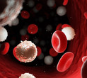
Leukemia Classification
Neural Network Project

Slide 2

OBJECTIVES
Introduction
Leukemia Classification Project Overview
Dataset Description
Preprocessing Steps
Model Development
Training and Evaluation
Results and Discussion
Thank you

Slide 3
Introduction
Leukemia is a type of blood cancer that affects a significant number of people worldwide. Detecting leukemia at an early stage is crucial for effective treatment and management of the disease. One way to do this is by examining blood cells under a microscope and identifying any abnormal cells. However, this process can be time-consuming and subject to human error.

Slide 4
Leukemia Classification Project Overview
The Leukemia Classification Project is an artificial intelligence project that aims to develop a deep learning model with (CNN)capable of accurately classifying microscopic images of blood cells into two categories: leukemia (ALL) and normal (Hem).
Leukemia Classification Objective:
The project is important as it can aid medical professionals in accurately and quickly diagnosing leukemia, a type of cancer that affects blood cells. The project utilizes machine learning and computer vision techniques to classify blood cells images with high accuracy.

Slide 5

Dataset Description
The Dataset that we worked in the project is: Leukemia Classification
We can download it easily through this link:
https://www.kaggle.com/datasets/andrewmvd/leukemia-classification
The dataset includes images of animal blood samples (i.e., containing blood cells) as well as samples of live and dead cells.

Slide 6
The leukemia classification dataset consists of:
In total there are 15,135 images in three folder (train,test,pred) from 118 patients with two labelled classes:
Normal cell (Hem labeled 0)
Leukemia blast (ALL labeled 1)
The images are in RGB format with Image size: 450 × 450 pixels. In trainfolder and predfolder
The images are in RGB format with Image size: 600 × 600 pixels. In testfolder
For training data we have 7272 in folder all ,3389 in folder hem.
For testing data, we have 2586 images.
For prediction data,we have 1867 images.

Slide 7
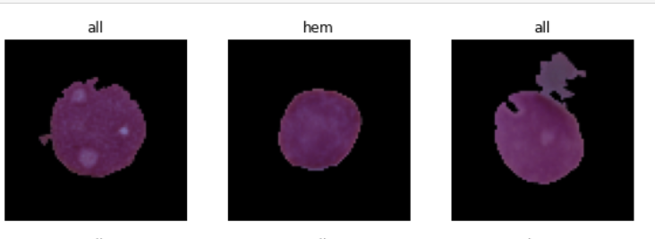
images of animal blood samples

Slide 8
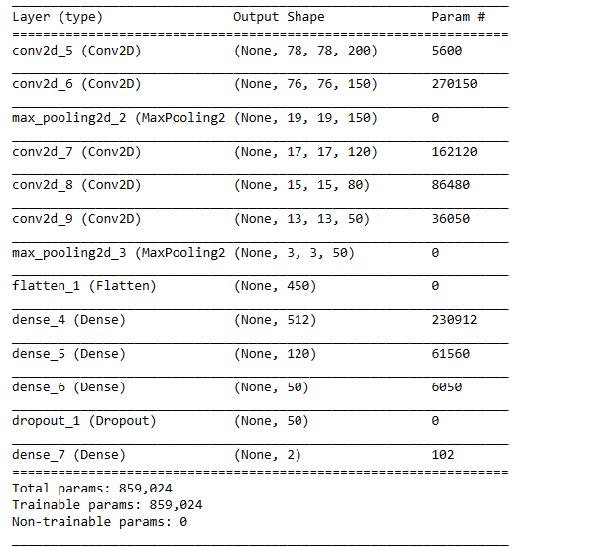
leukemia classification Details are:

Slide 9
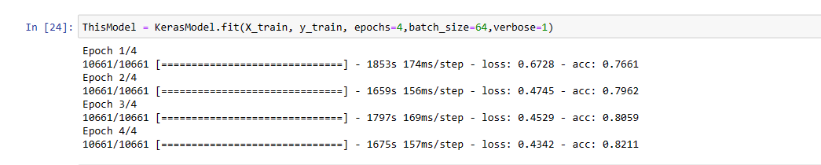
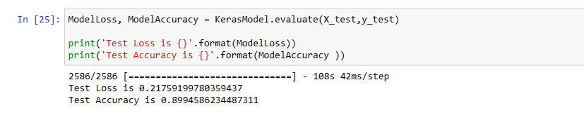
Training
Evaluation

Slide 10
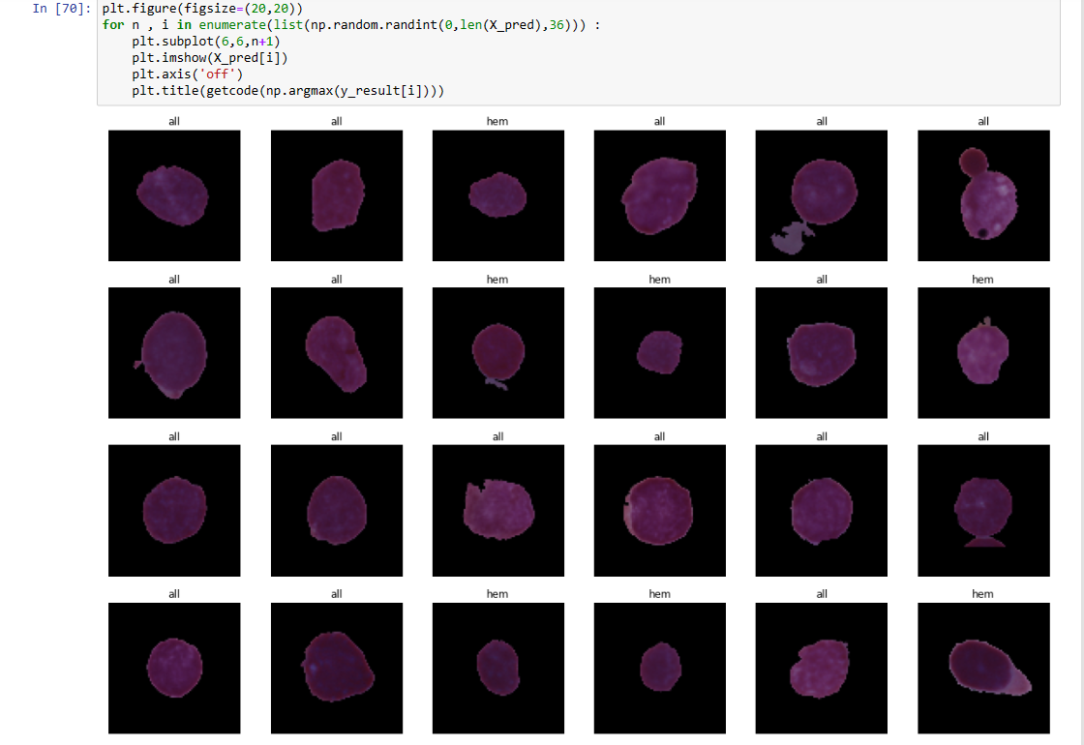
Results
Finally, pred all images in predfolder Successfully

Slide 11

THANK YOU

